Slide 2
Uta's presentation video on Youtube

Slide 3
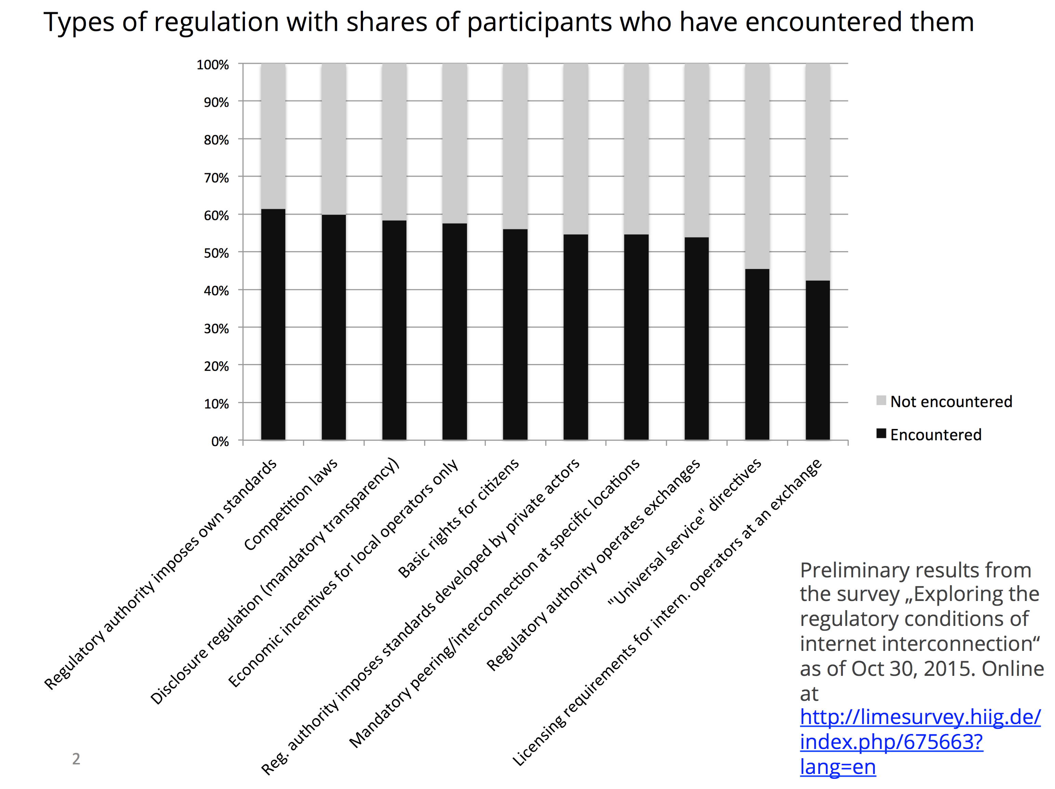

Slide 4
