Slide 1
A BCOP document: Implementing MANRS
Job Snijders (NTT)
Andrei Robachevsky (ISOC)

Slide 2
Have you heard of MANRS?

Slide 3
Mutually Agreed Norms for Routing Security (MANRS)
MANRS builds a visible community of security-minded operators
Promotes culture of collaborative responsibility
Defines four concrete actions that network operators should implement
Technology-neutral baseline for global adoption
Notes:
Almost a year ago a group of network operators came together to build a platform

Slide 4
Good MANRS
Filtering – Prevent propagation of incorrect routing information.
Anti-spoofing – Prevent traffic with spoofed source IP addresses.
Coordination – Facilitate global operational communication and coordination between network operators.
Global Validation – Facilitate validation of routing information on a global scale.
Notes:
Limited scope:
e.g. ensures correctness of their own announcements and announcements from their customers to adjacent networks with prefix and AS-path granularity
e.g. enables source address validation for at least single-homed stub customer networks, their own end-users and infrastructure
e.g. maintain globally accessible up-to-date contact information.

Slide 5
What is the problem?

Slide 6
Description is succinct
Lack of implementation guidance
Surprise: Still a high threshold for the implementation
Precise requirements are sometimes not clear
Leading to potential non-compliance with the norms

Slide 7
MANRS BCOP?

Slide 8
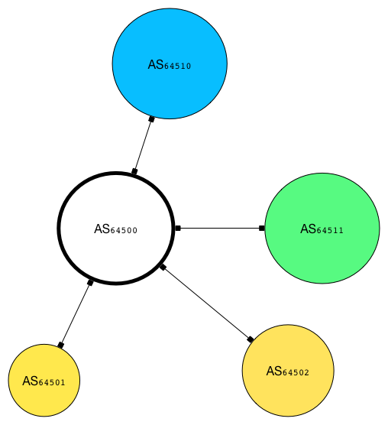
The Simplest Case

Slide 9
Answers how to
Ensure correctness of ISP’s own announcements and announcements from their customers to adjacent networks with prefix and AS-path granularity
Enable source address validation for at least single-homed stub customer networks, ISP’s own end-users and infrastructure.
Maintain globally accessible up-to-date contact information
Publicly document routing policy, ASNs and prefixes that are intended to be advertised to external parties.

Slide 10
Promote good practices in the spirit of MANRS
Already sent to this TF and NANOG BCOP
Form a more compact group of volunteers?

Slide 11
Does this sound like something you can contribute to? robachevsky@isoc.org & job@NTT.net

