Slide 1
Automated Certificate Management
ACME + Let’s Encrypt
Richard Barnes <rbarnes@mozilla.com>
@rlbarnes

Slide 2
What problem are we trying to solve?
Not enough use of encryption in applications
~40% of Firefox pageloads are HTTPS
~64% of Firefox HTTP transactions are HTTPS
~62% of emails received by Gmail are over STARTTLS
Routers? Home gateways?
These numbers should be 100%

Slide 3
Getting a certificate is no fun
“I can’t f’ing figure out how to get a cert from [redacted] - kid you not...
god help people that don’t know what a CSR is...
I am like 45 minutes in”
— Cullen Jennings, PhD Cisco Fellow Former IETF Area Director
Notes:
And that’s to say nothing of things like embedded devices / IoT / routers / home gateways, where there’s not even a possibility of having an adming configure each one

Slide 4
Let’s do DHCP for certificates
Notes:
When configuration got hard for IP addresses, we invented DHCP.

Slide 5
Initial efforts
SSLMate - Consistent REST API to a bunch of existing CAs
CertSimple - Semi-automated EV certificates
Let’s Encrypt - A new CA only accessible through a REST API
(more on Let’s Encrypt in a moment)

Slide 6
ACME
“Automated Certificate Management … Environment?”
Goal: One REST API that all CAs can use
… so that it makes sense to build tooling into things like web servers
Currently implemented by Let’s Encrypt
There’s an IETF working group
And an Internet-Draft
And you can contribute on Github

Slide 7
Getting a certificate with ACME
Make an account
Prove that you own some domains
Issue a certificate for that domain

Slide 8
Make an account
Create a key pair – this will be the “password” for your account
(All future messages to the server will be signed with this key pair)
Register the key pair with the CA, along with contact info

Slide 9
Prove you own some domains (1)
First you tell the server that you would like to be authorized for example.com
The server will ask you to prove that you control example.com
… by completing a challenge, like provisioning a file on http://example.com

Slide 10
Prove you own some domains (2)
Once you fulfill the challenge, you let the server know, and the server will check
If the expected file is there, your account is now authorized for example.com

Slide 11
Issue a certificate
Say you’re authorized for some names, like example.com and www.example.com
Then you can make a certificate just by making a Certificate Signing Request (CSR)
… and sending it to the CA

Slide 12
Register → Authorize → Issue
Three steps, all done with HTTP requests to the CA
There’s a little bit of signing magic to authenticate the client to the CA …
… but other than that, it’s just JSON over HTTP

Slide 13
And if anything should go wrong…

Slide 14
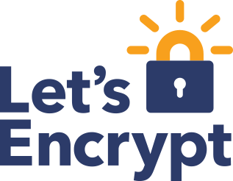

Slide 15
Let’s Encrypt is a new CA
Free - Non-profit, funded by sponsors
Automatic - The only way to get a certificate is through the API (ACME)
Secure - All SHA-2 from the start, ECDSA coming soon (also, no humans in the loop)
Transparent - All certificates logged to CT; public metrics
Open - All code is open source
Let’s Encrypt root CA is already in all your browsers!

Slide 16
How to get a certificate
General availability on December 3
Until then, sign up for the beta

Slide 17
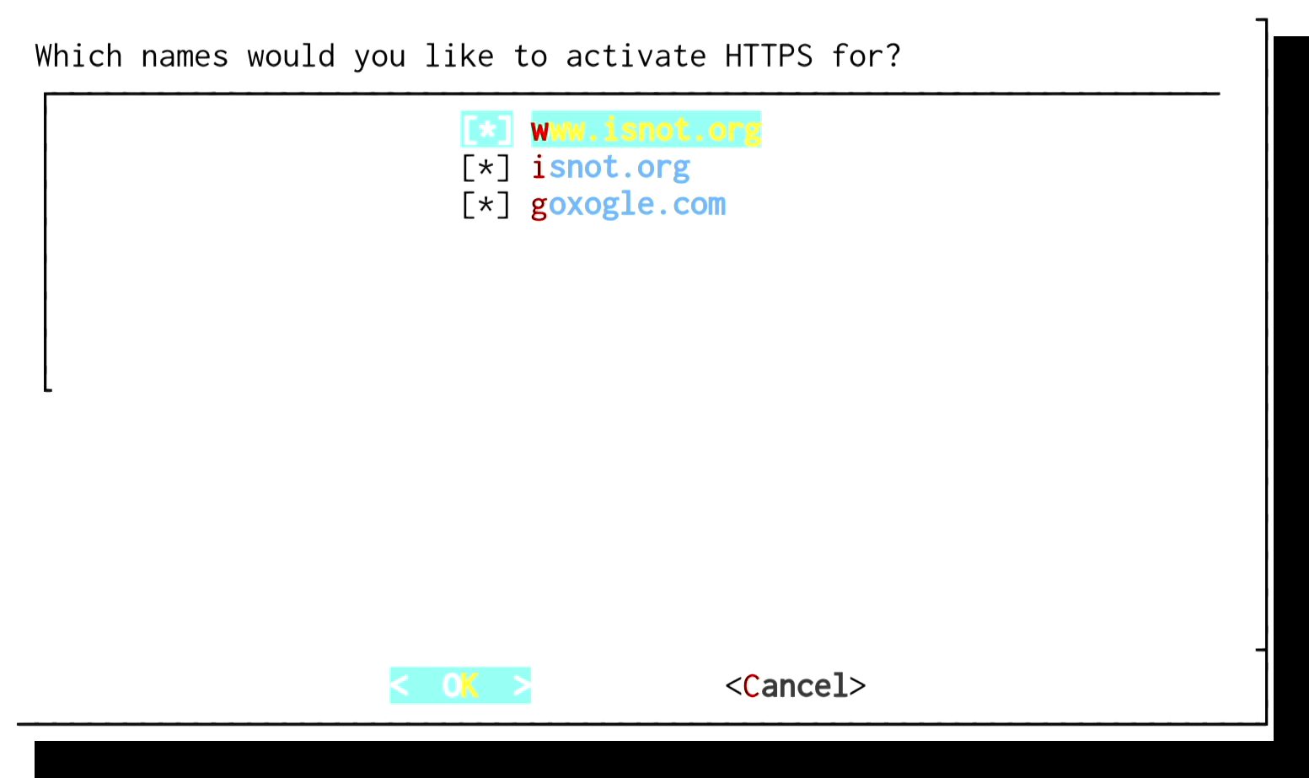
How to get a certificate
General availability on December 3
Until then, sign up for the beta
Use the futuristic* official client!
* Where “futuristic” == “works OK about 75% of the time; requires root; probably breaks your nginx; ...”

Slide 18
How to get a certificate
General availability on December 3
Until then, sign up for the beta
Use the futuristic* client software!
… or one of the various other clients that other people have written
… or use a server / hosting provider that has it integrated (e.g., Akamai)
… or write your own!

Slide 19
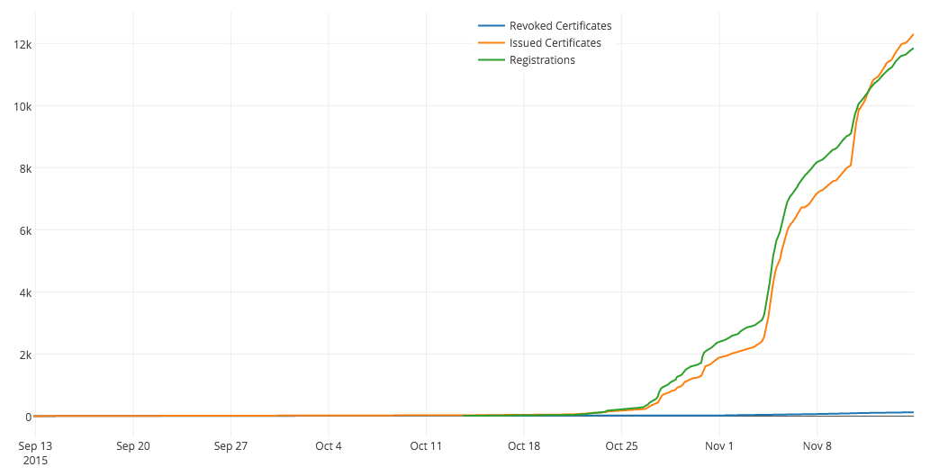
Up and to the right!

Slide 20
Security by Default
Everything we do on the net needs security
Security needs to be automatic
Let’s Encrypt on web servers is a good start
We need to apply this automation to more CAs and more things
What is still running unsecured in your network?

