Slide 1
The $1,000 Internet Exchange
WARNING: Contains up-and-to-the-right charts
Remco van Mook
UKNOF, September 2015

Slide 2
Before we start
This talk is about setting up not-for-profit, locally run, community-owned exchanges. Applicability in other scenarios may vary.
I’m not trying to push any vendor in particular – the examples given in this presentation are exactly that, examples.
There’s a big difference between setting up a new exchange from scratch and ‘parachuting in’ a satellite of an existing exchange
Your Mileage May Vary – local regulations can have a large impact!

Slide 3
Back in 2001
I bought 2 switches for an IXP
16x 1GE GBIC
48x 10/100M UTP
4x 1000W power supply
Over $100K price tag
And after a lot of hard work, I got 20 paid customers and 1Gbps of traffic
There was no market to research!

Slide 4
Back to 2015
There are plenty of IXPs around in all shapes and sizes
Market research is feasible
Higher speed Ethernet has been commoditized to pieces
Plenty of opportunity to learn from other people’s mistakes

Slide 5
WHAT to do if you’re a new IXP
Market Research
Build a Community
Build a Platform
(Figure out the content providers)

Slide 6
Market research
I’ll Tell You What You Want

Slide 7
Market Research
Data from Euro-IX, covering 204 IXPs from all over the world
Data from July 2015 – hot off the press!
Omitted all IXPs with no current traffic data (approx. 50)
How much traffic should a starting IXP expect/design for?

Slide 8
Global – ALL IXPs
54th percentile
20 Gbps

Slide 9
NON-EUROPEAN IXPs
69th percentile!
20 Gbps

Slide 10
Asiapac IXPs
42nd percentile!
20 Gbps

Slide 11
AfricaN IXPs
80th percentile!
20 Gbps

Slide 12
EUROPEAN IXPs
40th percentile!
20 Gbps

Slide 13
Market research conclusions
Traffic over 20Gbps is unlikely* for a startup
Design for an initial 15-20 customers
Initial revenue is low (if any)
* yes, there are exceptions, in places with highly developed local infrastructure and a lot of pressure from content providers, like FL-IX.

Slide 14
Paradigm for new IXPs
First, grow to scale.
Then, scale to grow.

Slide 15
Paradigms for helping new IXPs
Sponsor meeting rooms, not big gear
Facilitate LOCAL community building
Give them YOUR international contacts

Slide 16
Build a community
We could spend a day on this..

Slide 17
Guidelines
Be Inclusive
Be Pragmatic
(try to) Be Neutral

Slide 18
Select your setup
The 4 S-es of IXPs:
Switches, Servers, Software and Space

Slide 19
Requirements List
Capable of 20Gbps peak, 8Gbps average traffic
20-30 customer ports
10Mbps, 100Mbps, 1Gbps, multiple 1Gbps
Portal/website
Quarantine VLAN
Route server
Arpwatch
Central location with good connectivity options

Slide 20
Bursts, Buffers and port speeds
TL;DR – Don’t offer 10Mbps or 100Mbps ports. You will drop traffic.
Slightly longer explanation:
Switches are for forwarding traffic, not storing it
Cheap switches have modest buffers for storing traffic
Bursts of traffic from a 1G or 10G port towards a 10Mbps port will exhaust those
If a switch is out of buffers, it will drop traffic
Same thing goes for high port utilization!
Keep your port speed variance under 2 orders of magnitude!

Slide 21
Switch options
 | Traffic | Ports | Est. price (USD) | Max Power (W) | Example
Entry | 0-20G | 24 10/100/1000T | $347 | 32 | HP V1910-24G
 |  | 4 1G SFP
Entry+ | 0-20G | 48 10/100/1000T | $480 | 60 | HP V1910-48G
 |  | 4 1G SFP
Basic | 0-40G | 24 10/100/1000T | $837 | 34 | HP 1950 24xGbE 2xSFP+
 |  | 2 1G/10G SFP+
 |  | 2 1G/10G UTP
Basic+ | 0-40G | 48 10/100/1000T | $1,330 | 54 | HP 1950 48xGbE 2xSFP+
 |  | 2 1G/10G SFP+
 |  | 2 1G/10G UTP
Fiber | 0-40G | 24 1000 SFP | $1,860 | 60 | HP 5130-24G-SFP-4SFP+ EI
 |  | 8 10/100/1000T
 |  | 4 1G/10G SFP+
10G | 41-250G | 48 1G/10G SFP+ | $10,800 | 260 | HP 5900AF-48XG-4QSFP+
 |  | 4 40G QSFP+

Slide 22
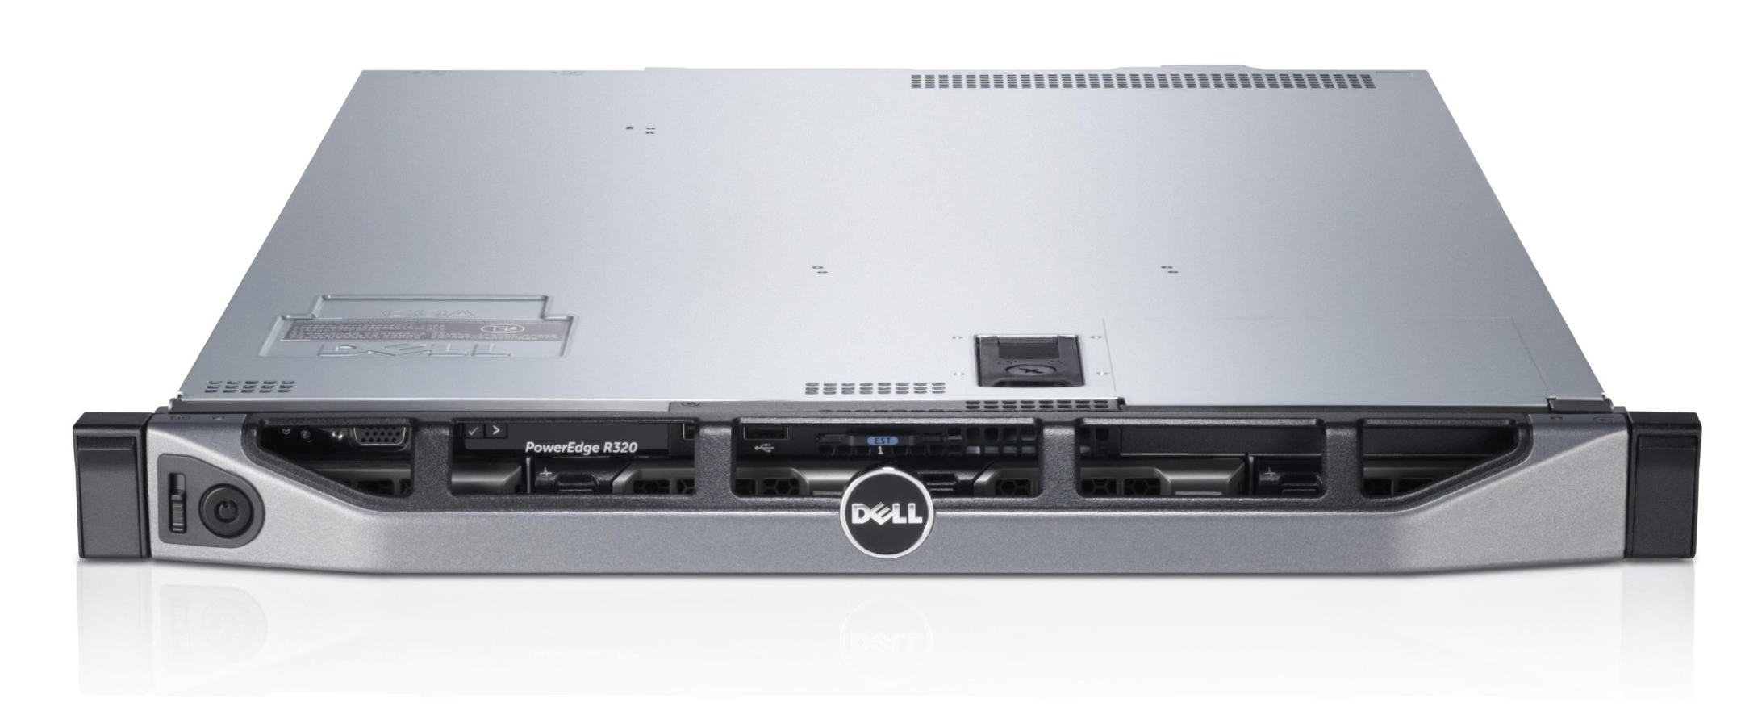
SERVER OPTIONS
 | Est. price (USD) | Typical Power (W) | Example
Entry | $502 | 25 | Supermicro dual core Atom, 4GB, 2x1T disk
Basic | $1,539 | 120 | Dell R320, 4C Xeon, 16GB, 2x1T disk
Pimp | $6,225 | 250 | Dell R530, 12C Xeon, 64GB, 2xSSD, 4x2T disk

Slide 23
SOFTWARE
A recent *BSD/Linux distribution (take your pick)
IXP Manager (https://github.com/inex/IXP-Manager/wiki)

Slide 24
SPACE
A mutually convenient, EXISTING space with EXISTING connectivity options
Assure neutral cable entry, roof rights and so on
The IXP requirements are modest compared to the connecting equipment
There’s no such thing as a free lunch

Slide 25
Business case
Technical Infrastructure Only!

Slide 26
“Half a million dollars will always be missed.”

Slide 27
assumptions
No organizational cost assumed – just the gear and keeping it running!
No import duties, taxes, VAT, license fees
It will take you 3 years to fill your ports
Power cost is $0.40/kWh
All datacenter costs are included in power cost
Revenue is projected based on port-months
1G port cost: $50 setup, $10 per month
10G port cost: $250 setup, $50 per month

Slide 28
Setup 1
DONE
Single site, local customer equipment, unknown uptake, no 10G
Per site:
1 “Entry” level switch: $350
1 “Entry” level server: $502
Cabling: $ 60
Cable management: $ 40
TOTAL $952
(20 customer ports, 1G copper, 67W power)

Slide 29
SETUP 1
Investment: $952
Power draw: 67W
Customer ports: 20x1G
 | Port-months | Revenue | Investment | Power cost | Margin
Year 1 | 30 | $550 | $952 | $232 | -$634
Year 2 | 90 | $1,150 | $0 | $232 | $918
Year 3 | 180 | $2,300 | $0 | $232 | $2,068
Total |  | $4,000 | $952 | $695 | $2,353

Slide 30
Setup 2
Expandable to 10Gbps / multiple Sites, local equipment
Per site:
1 “Basic” level switch: $808
1 “Entry” level server: $502
Optics: $100
Cabling: $100
Cable management: $ 80
TOTAL $1,590
(20 customer ports, 1G copper; 2 10Gbps ports, 69W power)

Slide 31
SETUP 2
Investment: $1590
Power draw: 69W
Customer ports: 20x1G, 2x10G
 | Port-months 1G | Port-months 10G | Revenue | Investment | Power cost | Margin
Year 1 | 30 |  | $550 | $1,590 | $238 | -$1,278
Year 2 | 90 | 6 | $1,700 | $50 | $238 | $1,412
Year 3 | 180 | 18 | $3,200 | $50 | $238 | $2,912
Total |  |  | $5,450 | $1,690 | $715 | $3,045

Slide 32
Setup 3
Expandable to 10Gbps / multiple Sites, mostly remote customer equipment
Per site:
1 “Fiber” level switch: $1,860
1 “Basic” level server: $1,539
Optics: $ 300
Cabling: $ 200
Cable management: $ 80
TOTAL $3,979
(20 customer ports 1G SMF; 8 1G copper; 4 10Gbps ports, 210W power)

Slide 33
SETUP 3
Investment: $3,979
Power draw: 210W
Customer ports: 28x1G, 4x10G
 | Port-months 1G | Port-months 10G | Revenue | Investment | Power cost | Margin
Year 1 | 42 | 6 | $1,220 | $3,979 | $726 | -$3,485
Year 2 | 126 | 18 | $2,660 | $50 | $726 | $1,884
Year 3 | 252 | 36 | $5,070 | $50 | $726 | $4,244
Total |  |  | $8,950 | $4,129 | $2,177 | $2,644

Slide 34
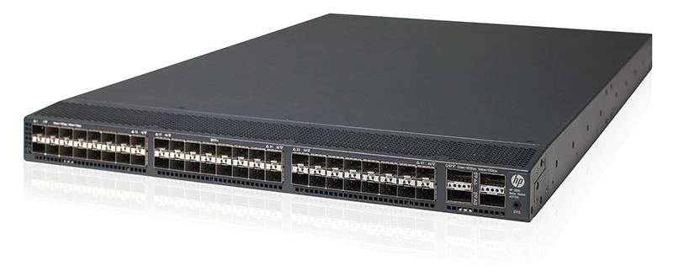
Setup 4
10G capable, local and remote customer connections, multiple sites
Per site:
1 “10G” level switch: $10,800
1 “Basic” level switch: $ 808
1 “Pimp” level server: $ 6,225
1 “Basic” level server: $ 1,539
Optics: $ 1,300
Cabling: $ 500
Cable management: $ 250
TOTAL $21,422
(44 customer ports 1G/10G SMF; 24 1G copper; 4 40Gbps ports, 744W power)

Slide 35
SETUP 4
Investment: $21,422
Power draw: 744W
Customer ports: 36x1G, 36x10G
 | Port-months 1G | Port-months 10G | Revenue | Investment | Power cost | Margin
Year 1 | 54 | 54 | $5,940 | $21.422 | $2,571 | -$18,053
Year 2 | 162 | 162 | $12,420 | $450 | $2,571 | $9,399
Year 3 | 324 | 324 | $24,840 | $900 | $2,571 | $21,369
Total |  |  | $43,200 | $22,772 | $7,714 | $12,714

Slide 36
DUMPSTER DIVING
10G capable, local and remote customer connections, multiple sites
Per site:
1 Brocade MLX-16, 6 4x10GE cards, 2 24x100/1000 cards, 3,500W $0
2 HP Proliant DL360 Gen5, Dual quad-core Xeon, 16GB, 500W each $0
Optics: $0
Cabling: $0
Cable management: $0
TOTAL $0
(24 customer ports 1G copper; 24 1G SMF; 24 10Gbps ports, 4,500W power)

Slide 37
Dumpster Diving
Investment: $0
Power draw: 4,500W
Customer ports: 48x1G, 24x10G
FAILED
 | Port-months 1G | Port-months 10G | Revenue | Investment | Service | Power cost | Margin
Year 1 | 72 | 36 | $4.620 | $500 | $25.000 | $15.552 | -$36.432
Year 2 | 216 | 108 | $9.660 | $500 | $25.000 | $15.552 | -$31.392
Year 3 | 432 | 216 | $19.320 | $500 | $25.000 | $15.552 | -$21.732
Total |  |  | $33.600 | $1.500 | $75.000 | $46.656 | -$89.556

Slide 38
Dumpster Diving
Investment: $0
Power draw: 4,500W
Customer ports: 48x1G, 24x10G
1G port cost: $250 setup, $50 per month
10G port cost: $500 setup, $200 per month
 | Port-months 1G | Port-months 10G | Revenue | Investment | Service | Power cost | Margin
Year 1 | 72 | 36 | $16.800 | $500 | $25.000 | $15.552 | -$24.252
Year 2 | 216 | 108 | $38.400 | $500 | $25.000 | $15.552 | -$2.652
Year 3 | 432 | 216 | $76.800 | $500 | $25.000 | $15.552 | $35.748
Total |  |  | $132.000 | $1.500 | $75.000 | $46.656 | $8.844

Slide 39
A $100K switch setup
10G capable, local and remote customer connections, multiple sites
Per site:
1 Big Vendor switch, 48x1G ports, 24x10G ports, 1,880W $99,470
1 “Pimp” level server: $ 6,225
1 “Basic” level server: $ 1,539
Optics: $ 1,300
Cabling: $ 500
Cable management: $ 250
TOTAL: $109,284
(24 customer ports 1G copper; 24 1G SMF; 24 10Gbps ports, 2,250W power)

Slide 40
A $100K switch setup
FAILED
Investment: $109,284
Power draw: 2,250W
Customer ports: 48x1G, 24x10G
 | Port-months 1G | Port-months 10G | Revenue | Investment | Service | Power cost | Margin
Year 1 | 72 | 36 | $4,620 | $109,284 | 0 | $7,776 | -$112,440
Year 2 | 216 | 108 | $9,660 | $450 | $24,500 | $7,776 | -$23,066
Year 3 | 432 | 216 | $19,320 | $900 | $24,500 | $7,776 | -$13,856
Total |  |  | $33.600 | $110.634 | $49,000 | $23,328 | -$149,362

Slide 41
A $100K switch setup
Investment: $109,284
Power draw: 2,250W
Customer ports: 48x1G, 24x10G
1G port cost: $300 setup, $65 per month
10G port cost: $1,500 setup, $275 per month
 | Port-months 1G | Port-months 10G | Revenue | Investment | Service | Power cost | Margin
Year 1 | 72 | 36 | $27,180 | $109,284 | 0 | $7,776 | -$89,880
Year 2 | 216 | 108 | $56,340 | $450 | $24,500 | $7,776 | $23,614
Year 3 | 432 | 216 | $112,680 | $900 | $24,500 | $7,776 | $79,504
Total |  |  | $196.200 | $110.634 | $49,000 | $23,328 | $13,238

Slide 42
Figuring out the content side

Slide 43
“Build it and we will come”*
Getting content providers adds enormous value to your IXP
But it comes at a price – which is a separate business case!
Typical requirements:
free IP transit, free space & power
The upside:
total IP transit cost for the community goes down
Much improved user experience
*As long as it’s free (for us).

Slide 44
Best Practices
Progress since May

Slide 45
IGF BPF IXP
Last weeks IGF had the BPF sessions (best practices forum)
Included in those sessions was one about IXPs, and a document was prepared in advance: http://www.intgovforum.org/cms/documents/best-practice-forums/536-igf15-bpf-ixp-jp-draft
Section 1.4 reads as follows: “The IGF is not an appropriate forum to discuss or teach the technical knowhow that is needed to create and/or run an IXP, nor is it a technical manual for routers and switches. There are specialist meetings and forums that dive into the technical details of how to establish, operate, and sustain an IXP. In addition, technical guidelines and reference documents are available from IXP operators and managers. For those seeking technical guidance and technical best practices, a non­ exhaustive overview of reference documents from IXP ­related fora has been included in this document (see Appendix 1).”

Slide 46
Final remarks
You don’t need a huge budget
You DO need a solid community (inclusive, pragmatic, neutral)
Don’t be afraid to upgrade
Just about everything else is more important than the IXP hardware
If you want resilience, build more IXPs

Slide 47
THANK YOU
Please come see me after the session or send e-mail!
With special thanks to Euro-IX for providing IX traffic data!
Remco van Mook
remco.vanmook@gmail.com

