Slide 1
Meet the Falcons
Ciprian Marginean
ciprian.marginean@ams-ix.net
Aris Lambrianidis
aris.lambrianidis@ams-ix.net
Notes:
Hello everyone! My name is Ciprian Marginean, I'm a network engineer at the Amsterdam Internet Exchange and today I'm going to introduce you to our newest family members, the Falcons! Earlier this year, in May, my colleagues Aris Lambrianidis and Thijs Burema have presented at the MORE-IP event, our intention of joining the fight against BGP prefix highjacking by building a system of tools that enable our members and customers to quickly set up policies on their routers without the need of going through the effort of installing any of the infrastructure needed on their side.

Slide 2
What are the Falcons?
A new pair of route servers
Based on BIRD (Cisco does not scale easily nor support all features)
Available only in Amsterdam (for now)
Notes:
The Falcons are code-name for a new pair of route servers based on BIRD version 1.5, hence the name, and are available for now only at the Amsterdam exchange point. We chose BIRD for this new implementation because of the proven stability so far and because the other vendor's equipment does not scale to over 700 peers or don't support all the features needed.
Label valid and unknown prefixes using BGP communities in both cases
Any prefixes not filtered (explained in 2.), will be tagged using standard BGP communities given in the parentheses. Prefixes announced by the new route servers will be tagged according to the criteria shown below:
a. Prefix has ROA status: VALID (6777:65012) b. Prefix has ROA status: INVALID (6777:65022) c. Prefix has ROA status: UNKNOWN (6777:65023) d. Prefix is present in an AS's announced AS/AS-SET (6777:65011) e. Prefix is not present in an AS's announced AS/AS-SET (6777:65021)

Slide 3
Why go to the trouble?
Prefix hijack (or misconfiguration) mitigation
“no mechanism has been specified within BGP to validate the authority of an AS to announce NLRI information (prefixes)” (RFC4272 3.2)
Notes:
After attending yesterday's presentations It's becoming clear to me that most of you present here are aware that the Internet is far from being a perfect place in terms of security and that Internet service providers are confronted daily with prefix highjacking. It's not only our customers that are affected by these events, in fact we're all suffering because of them. Some lose customers, some lose revenue, and some of us loose sleep and gain gray hairs.
Hijacking caused by:
1. Misconfiguration
2. Malicious intent

Slide 4
How do we do it?
RPKI validation (RFC6480)
BGP community tagging based on RPKI status (valid, invalid, unknown)
IRRdb object filtering or tagging
Notes:
How does the system work? We basically have to ways of checking for prefix validity: RPKI and the IRRdb. The BGP router parses each incoming announcement and checks the prefix against the ROA entries for RPKI or against the "route-object" entries for IRRdb. Depending on the results we tag the prefix with unique BGP communities corresponding to the valid, invalid, or unknown state.

Slide 5
What’s new to the Falcons?
Feature | Legacy | Falcon
BGP community based routing policies
IRRdb based routing policies
Inbound Routing Policies
RPKI prefix validation and filtering
IRRdb prefix validation and filtering
AS Path prepending
Notes:
Apart from the RPKI and IRRdb prefix validation and filtering features, we've added to the Falcons some other exciting ones like: BGP community based routing policies. and per neighbour AS-PATH prepending .
AS-Path prepending can be done via the Falcon class Route Servers by tagging prefixes:
a. using 6777:65501, to prepend the customer AS once (e.g. 1200:65501) b. using 6777:65502, to prepend the customer AS twice (e.g. 1200:65502) c. using 6777:65503, to prepend the customer AS thrice (e.g. 1200:65503)
Path hiding should not be a problem, as we are employing the BIRD “secondary” configuration option.

Slide 6
Is it difficult to configure?
Notes:
In order to peer with the Falcons our members and customers just need to login into the my.ams-ix portal, scroll down to the IP configuration section then click the "Enable Falcon peering" button.

Slide 7
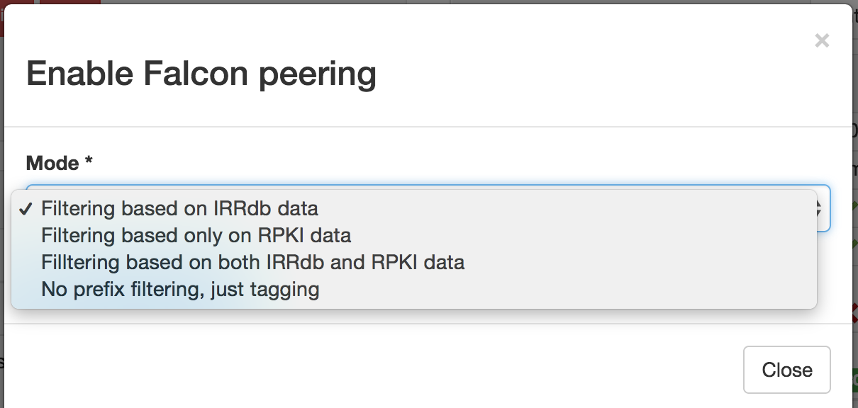
One more click…
Notes:
After this you're gonna be presented with a dropdown menu from were you can choose to receive only valid prefixes filtered by either the RPKI or IRRdb info or both. And if you fancy doing the filtering yourself, select No prefix filtering, just tagging and the Falcon will send you everything tagged with communities.
2. Offer more control with regards to prefixes announced to peers
Customers will be able to choose between four options in the AMS-IX customer portal applicable to announcements received via the Falcon class Route Servers:
a. No filtering applied to announced prefixes b. Filter prefixes not present in an AS's announced AS/AS-SET (this is the default if no other option has been selected) c. Filter prefixes with ROA status: INVALID d. Filter prefixes with ROA status: INVALID as well as prefixes not present in an AS's announced AS/AS-SET (that is, do both b. and c.)

Slide 8
The stats
Active peers: 35
Notes:
The Falcons have been up and running for the past 2 and a half months and by now we have 35 active peers and a total of roughly 1600 prefixes. As you can see on the pie chart the RPKI adoption is quite low: less than 6% of the advertised prefixes have ROA entries and about 1% of them are invalid. On the IRRdb side things are looking a bit better: roughly 70 percent of the prefixes are valid.
Prefixes: 1631
Active peers: 35
IRRdb Valid: 1164
IRRdb Invalid: 467
ROA Valid: 92
ROA Invalid: 15
ROA Unknown: 1524

Slide 9
Key take aways?
Lower the barrier for customers needing more tools to make security focused decisions
The routing policy is still controlled by the customer
The Falcons are running in production in parallel with existing ones
Notes:
What do we want to accomplish with this? If you are a service provider and want to implement RPKI you would need to do some, or all of the following: install and run a RPKI validator instance, upgrade your equipment to a recent software version and rethink your routing policy configuration.
Cisco IOS – solid in 15.2 – Cisco IOS/XR – shipped in 4.3.2 – Juniper – shipped in 12.2

Slide 10
Notes:
So why not letting us be your Sherpa and carry the heavy stuff up the mountain while you concentrate on what you do best:

Slide 11
Key take aways?
Lower the barrier for customers needing more tools to make security focused decisions
The routing policy is still controlled by the customer
The Falcons are running in production in parallel with existing ones
Notes:
skip

Slide 12
Notes:
Drive the network in a safe and responsible manner

Slide 13
Key take aways?
Lower the barrier for customers needing more tools to make security focused decisions
The routing policy is still controlled by the customer
The Falcons are running in production in parallel with existing ones
Notes:
You may ask why not just "backport" the RPKI/IRRdb validation features to the Legacy Route Servers instead of providing another set?

Slide 14
Notes:
Well, this pertains to our philosophy of maintaining our neutrality as an entity. At the same time, we aim to avoid forcing the service to customers who potentially would consider it obtrusive, out of scope, or even harmful to their operations.

Slide 15
Will there be anything else, sir?
Highly flexible, per peer BGP attribute manipulation using communities:
set MED
set ORIGIN
set prepend AS
BGP ADD-PATH
More configuration options: (IRRDB or Web portal)+ communities
DDoS attack mitigation – L2 filtering
Notes:
I'm gonna wrap up on the further development slide. We are thinking of implementing in the near future some more useful features for BGP traffic engineering, like per peer attribute manipulation using communities, BGP-ADD-path and DDOS attack mitigation and filtering.

Slide 16
Any questions? This is still WiP, any feedback is welcome!
noc@ams-ix.net
Notes:
Closing, I want to emphasize that this is still work in progress and any suggestions are much appreciated. Thank you all for listening. Any questions or comments?
FAQ:
Q: Is a Looking Glass service being offered for the "Falcon" class Route Servers? A: Yes, you can use the Customer Portal to reach it, under Options > Looking Glass.
Q: Are the "Falcon" class Route Servers available in all AMS-IX exchanges? A: The service is currently only available for the Amsterdam platform. Depending on customer interest, it is possible to offer it in our other exchanges as well.
Q: What methods can I use to describe our AS routing policy? A: "Falcon" class Route Servers offer a standard BGP community mechanism to influence outbound routing policies. Please see here for more details.
Q: Can I use import/export policies in IRRdb objects to express routing policy for the "Falcon" class route servers? A: This is not supported for "Falcon" class route servers. Planned support for such a feature will depend on customer interest.
Q: Should I peer with the Legacy Route Servers or the "Falcon" class ones? A: Customers and members are free to peer with both services, either, or none.
The only requirement is to ensure you're peering with both members of a set (if you're peering with rs1 you have to have a session with rs2, and if you're peering with rs3 you have to have a session with rs4), as true redundancy is achieved only if both members of a set carry the exact same prefixes.
Q: We are using "announce ANY" instead of "announce AS/AS-SET" for our export attributes. How is AMS-IX determining whether our announcements can be resolved as route objects with our AS as an origin (that is, validate via an IRRdb)? A: We consider the "ANY" keyword equivalent to "advertising AS", as there is no other way to provide meaningful information about such announcements. Should that not reflect your AS's routing policy, please update your export attribute with an appropriate AS-SET.
Q: Why not just "backport" the RPKI/IRRdb validation features to your Legacy Route Servers instead of providing another set? A: This pertains to our philosophy of maintaining our neutrality as an entity. We aim to avoid forcing the service to customers who potentially would consider it obtrusive, out of scope, or even harmful to their operations.
Q: Are 32-bit ASNs supported when specifying BGP communities for routing policies? A: Yes. You can use the "route target" BGP extended communities to specify the communities you wish.
Q: How are you validating prefixes via RPKI? A: We are running a standard RIPE NCC RPKI validator , using the following Trust anchors:
APNIC (from AFRINIC RPKI Root)
APNIC (from ARIN RPKI Root)
APNIC (from IANA RPKI Root)
APNIC (from LACNIC RPKI Root)
AfriNIC (RPKI Root)
LACNIC (RPKI Root)
RIPE NCC (RPKI Root)
Q: Why did you name the route servers "Falcon"? A: Falcon is a BIRD species :)
Q: We are peering with both route server sets. Can I specify a separate routing policy for each? A: This will be available soon using the "at" keyword in object attributes. Note that this initially will only affect IRRdb prefix validation, it will not allow specifying IRRdb based routing policies.

