Slide 1
IANA Update
Elise Gerich | RIPE 71, Bucharest, Romania| November 2015

Slide 2
IANA Update
Registry Update – RDAP Servers
IPv4 Recovered Pool Allocation
RDNS CA
H-root server Announcement
2015 IANA Customer Service Survey

Slide 3
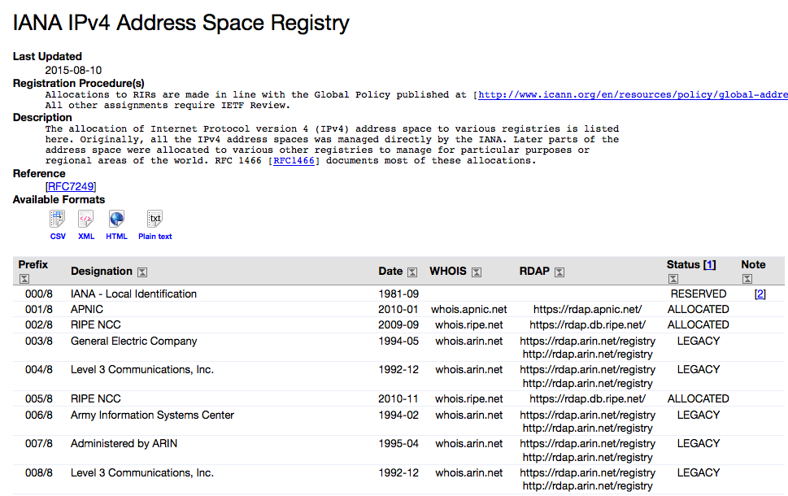
Registry Update – RDAP Servers
RDAP
Notes:
Registration Data Access Protocol (RDAP) – WHOIS alternative
We updated the IPv4, IPv6 and AS Number registries
APNIC’s RDAP Service: rdap.apnic.net/

Slide 4
IPv4 Recovered Pool Allocations
ALLOCATION FROM RECOVERED POLL
1 September 2015: Each RIR received the equivalent of a /14
Next allocation will take place 1 March 2016
Registry: http://www.iana.org/assignments/ipv4-recovered-address-space
Allocation tool: https://github.com/icann/ipv4-recovery-algorithm
Global policy: https://www.icann.org/resources/pages/allocation-ipv4-post-exhaustion-2012-05-08-en

Slide 5
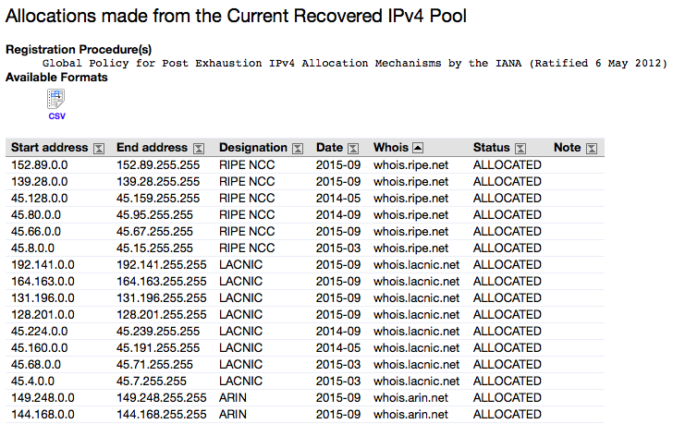
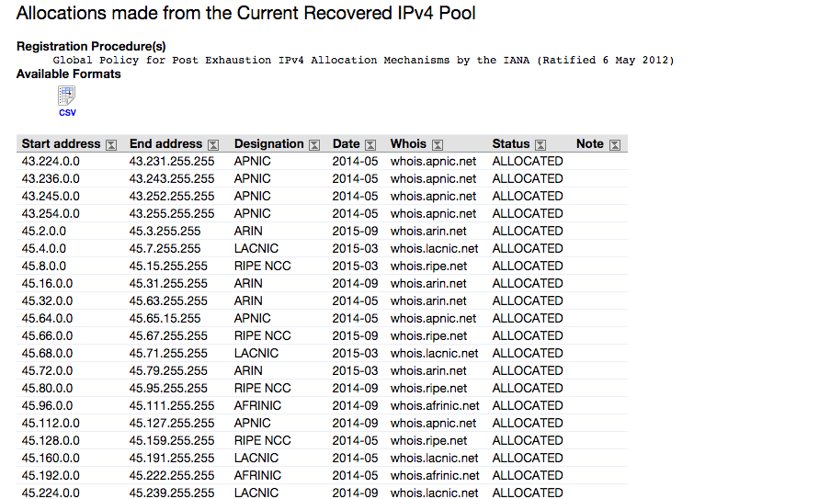
IPv4 Recovered Pool Allocations

Slide 6
IPv4 Recovered Pool Allocations
Mar
2016
Sep
2016
Mar
2017
Sep
2017
Mar
2018
Sep
2018
Mar
2019
/15
/18
/19
/20
/21
/22
/23
Last Allocation
If we do not receive additional returned addresses, the last allocation from the recovered pool will take place in March 2019. After that, the recipient size would not be large enough to satisfy the global policy minimum.

Slide 7
RDNS CA
Reverse DNS (rDNS) CERTIFICATE CHANGE
The ICANN RDNS CA expires on 13 March 2016
Consulted with RIRs and received their agreement to the proposed schedule
RIRs submitted new CSRs to ICANN by the beginning of November
Rollover was completed on 13 November 2015

Slide 8
Announce Upcoming Root Server Change
NOTIFICATION OF UPCOMING Change of IP Address of H root server
New IPv4 Address: 198.97.190.53
New IPv6 Address: 2001:500:1::53
Change will be implemented on 1 December 2015
New hints files will be available at the following:
http://www.internic.net/domain/named.root
http://www.internic.net/domain/named.cache
You can monitor the transition here:
http://h.root-servers.org/old_vs_new.html

Slide 9
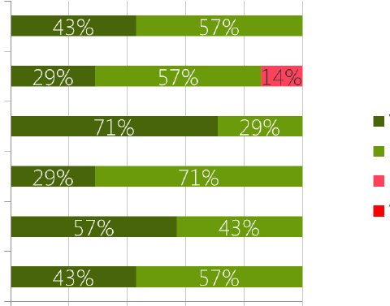
Annual Customer Service Survey
2015 IANA functions Customer Service Survey
Process Quality
Quality of Instructions
Courtesy
Timeliness
Feedback
Accuracy
Very Sat
Satisfied
Dissatisfied
Very Dissat
0% 20% 40% 60% 80% 100%

Slide 10
Thank you!
Questions?
Reach us at:
Email: iana@iana.org
Website: iana.org
Thank you!

