Slide 1
GoBGP : yet another OSS BGPd
Wataru ISHIDA
NTT Software Innovation Center
RIPE-71
Bucharest, November 2015

Slide 2
GoBGP
Open Source BGP implementation
https://github.com/osrg/gobgp
Written in Go
Main Target Applications
High performance Route Server for IX
Integration with data analysis systems
3. BGPd for white box switches

Slide 3
Motivation
Why another BGP implmentation?
SDN Era has begun
We need SDN-Native BGP implementation !

Slide 4
GoBGP Overview
What SDN-Native means
High Performance
Existing OSS BGPd are mainly single-threaded
GoBGP can exploit multicore
Aimed to be run on modern/commodity hardwares

Slide 5
GoBGP Overview
What SDN-Native means
High Performance
API-first Architecture
Existing BGPd are mainly CLI-first
Automation/Integration using “expect” is painful…
GoBGP uses gRPC
10 languages binding
Integration with your software is smooth

Slide 6
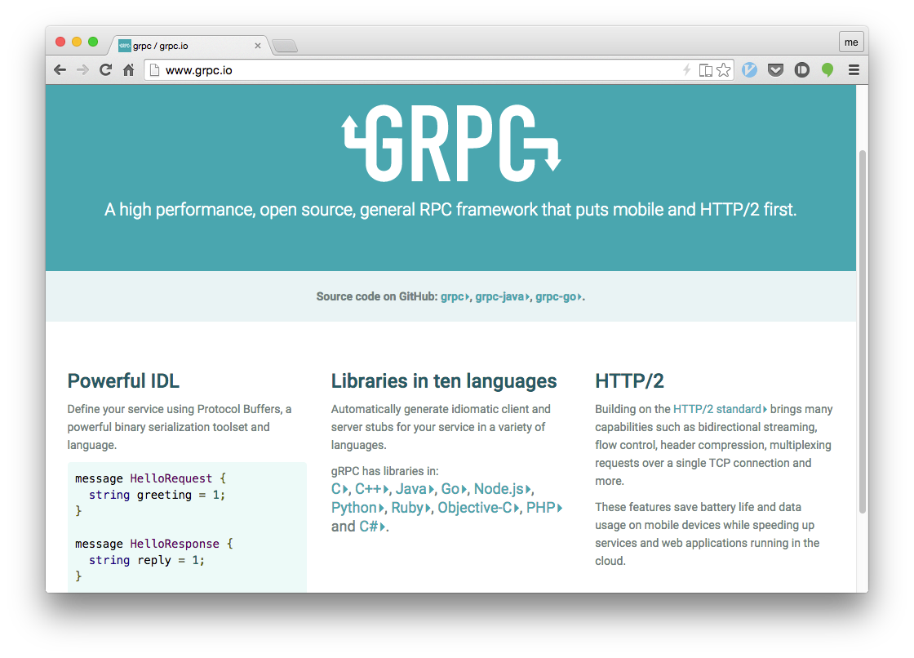
GoBGP Overview

Slide 7
GoBGP Overview
What SDN-Native means
High Performance
API-first Architecture
Vendor-Neutral Configuration Model
Existing BGPd configuration varies
GoBGP uses OpenConfig
YANG model for BGP
draft-ietf-idr-bgp-model-00
Cisco’s support just announced

Slide 8
GoBGP Overview
What SDN-Native means
High Performance
Go
API-first Architecture
gRPC
Vendor-Neutral Configuration Model
OpenConfig

Slide 9
GoBGP Basics
gobgp (CLI)
Your Software
gRPC
gobgpd (daemon)
Comes with two binary
gobgpd : bgp daemon
gobgp : cli tool (uses gRPC underneath)

Slide 10
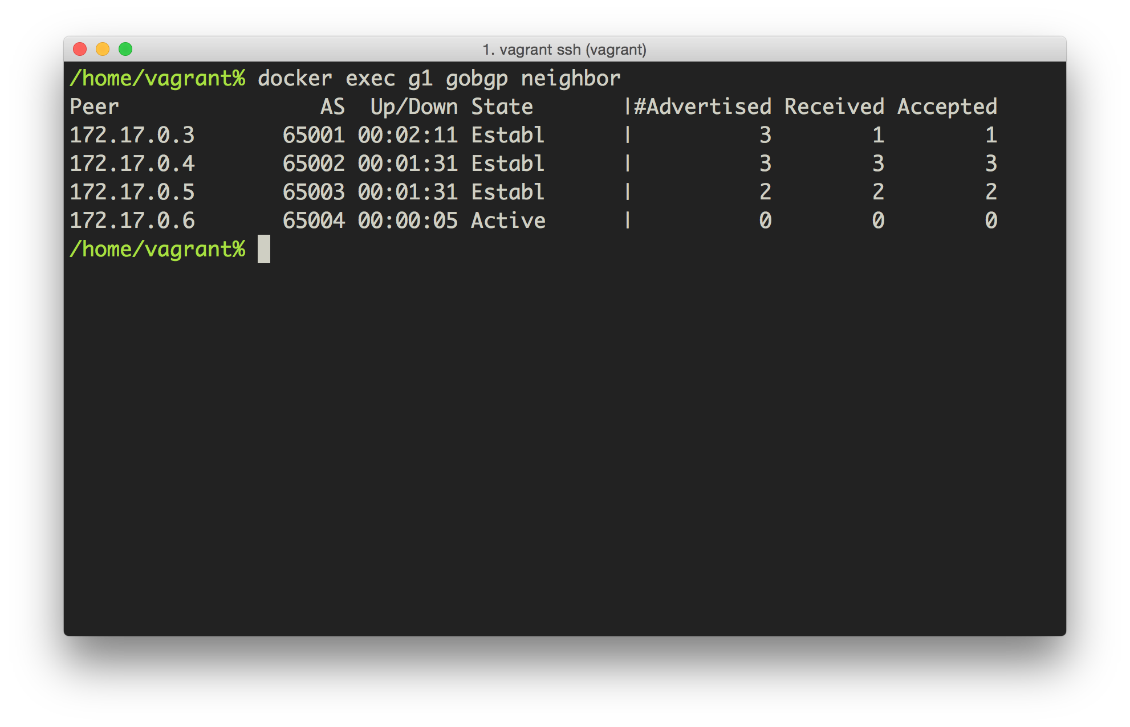
GoBGP Basics – show neighbors

Slide 11
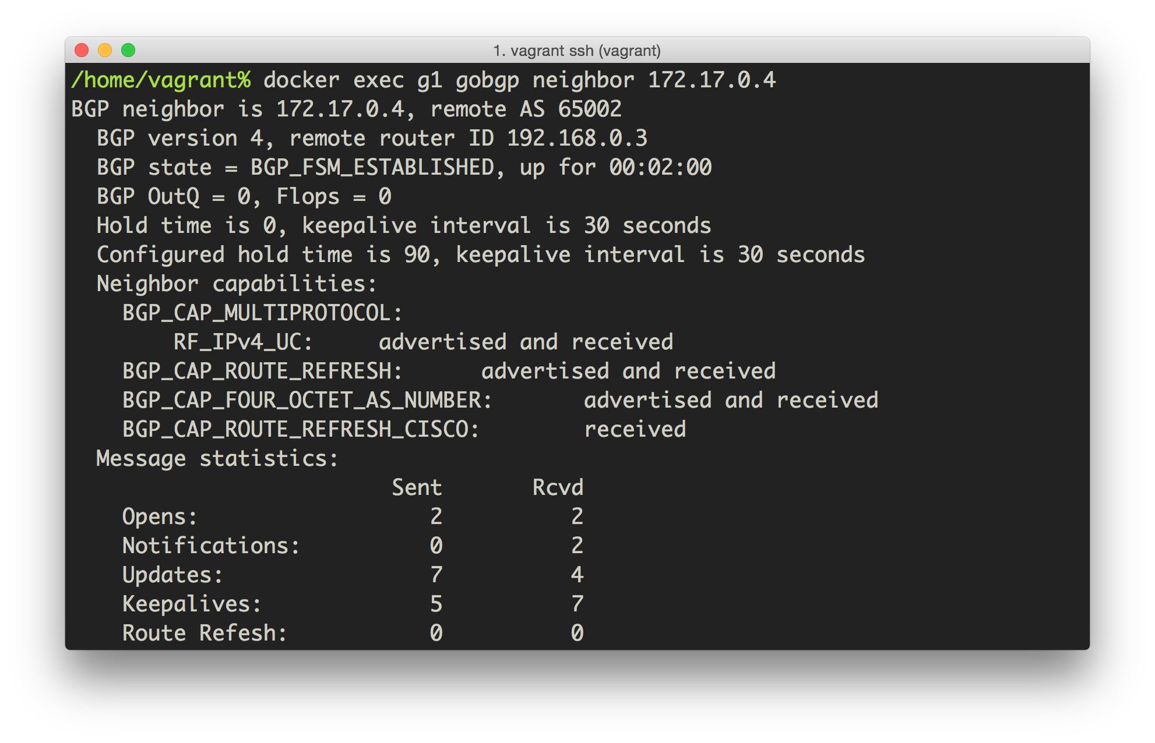
GoBGP Basics – show neighbor

Slide 12
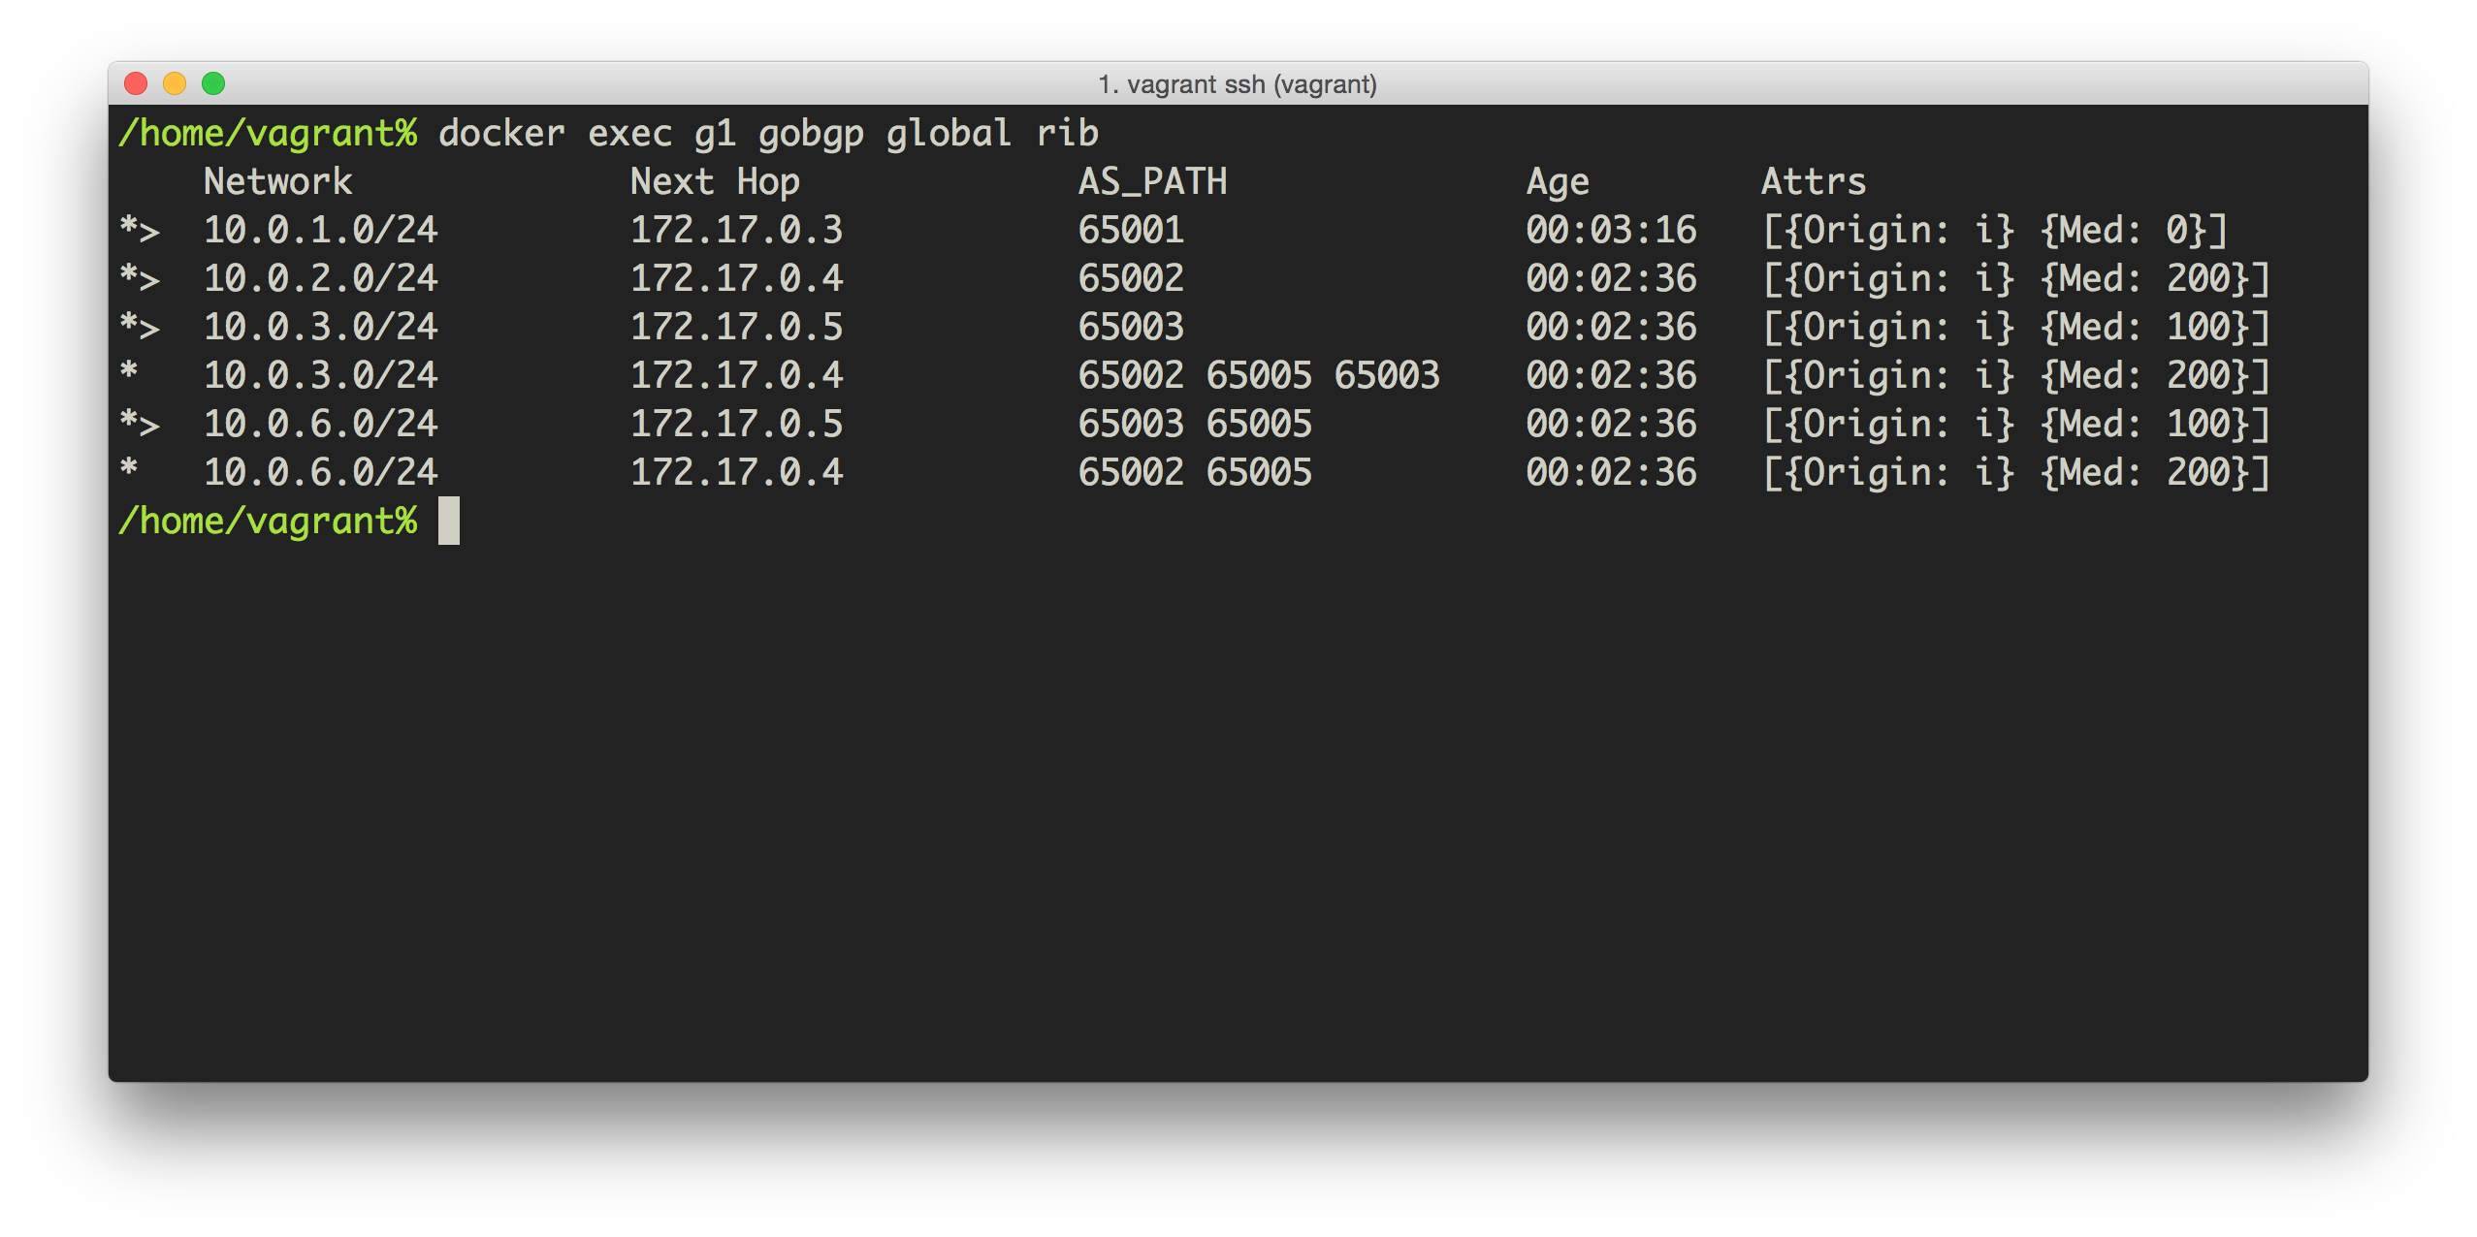
GoBGP Basics – show global rib

Slide 13
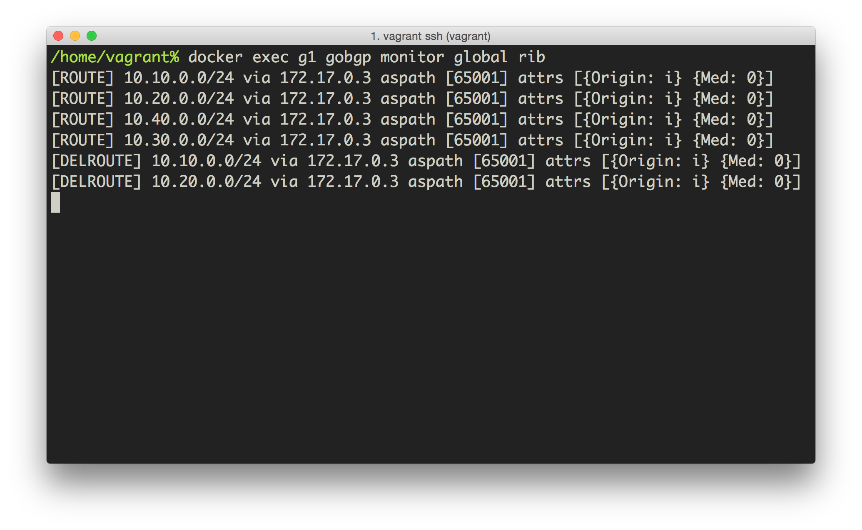
GoBGP Basics – monitor new best

Slide 14
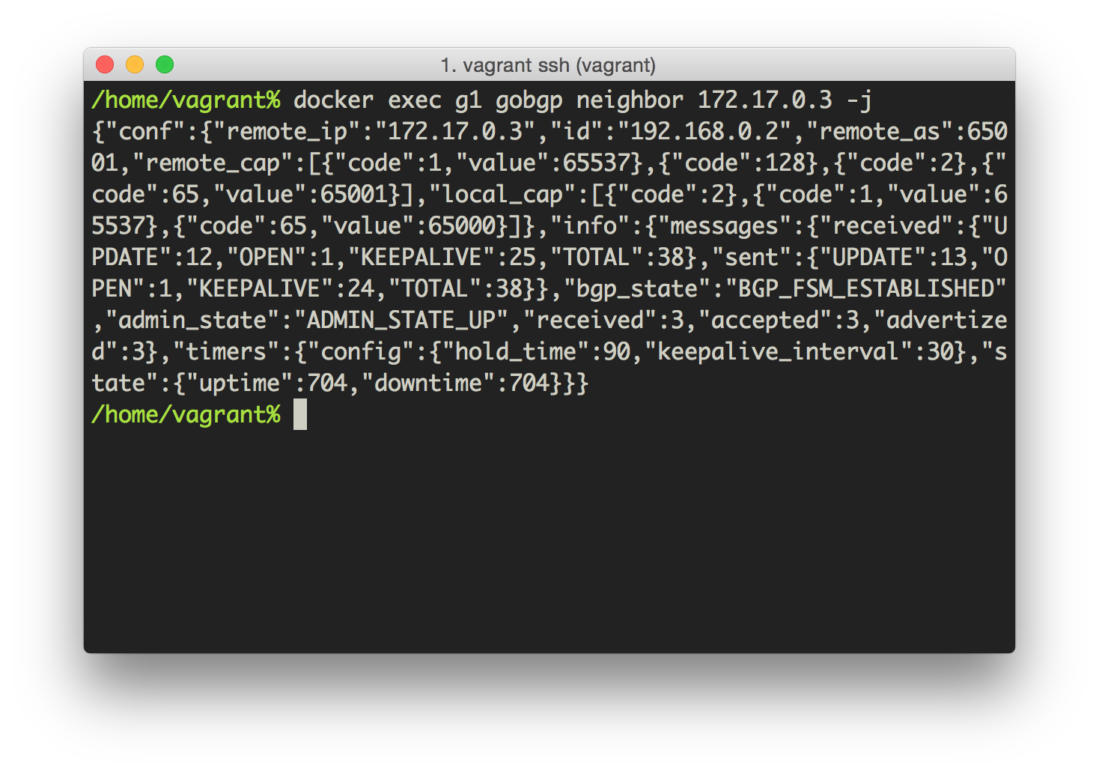
GoBGP Basics - json option

Slide 15
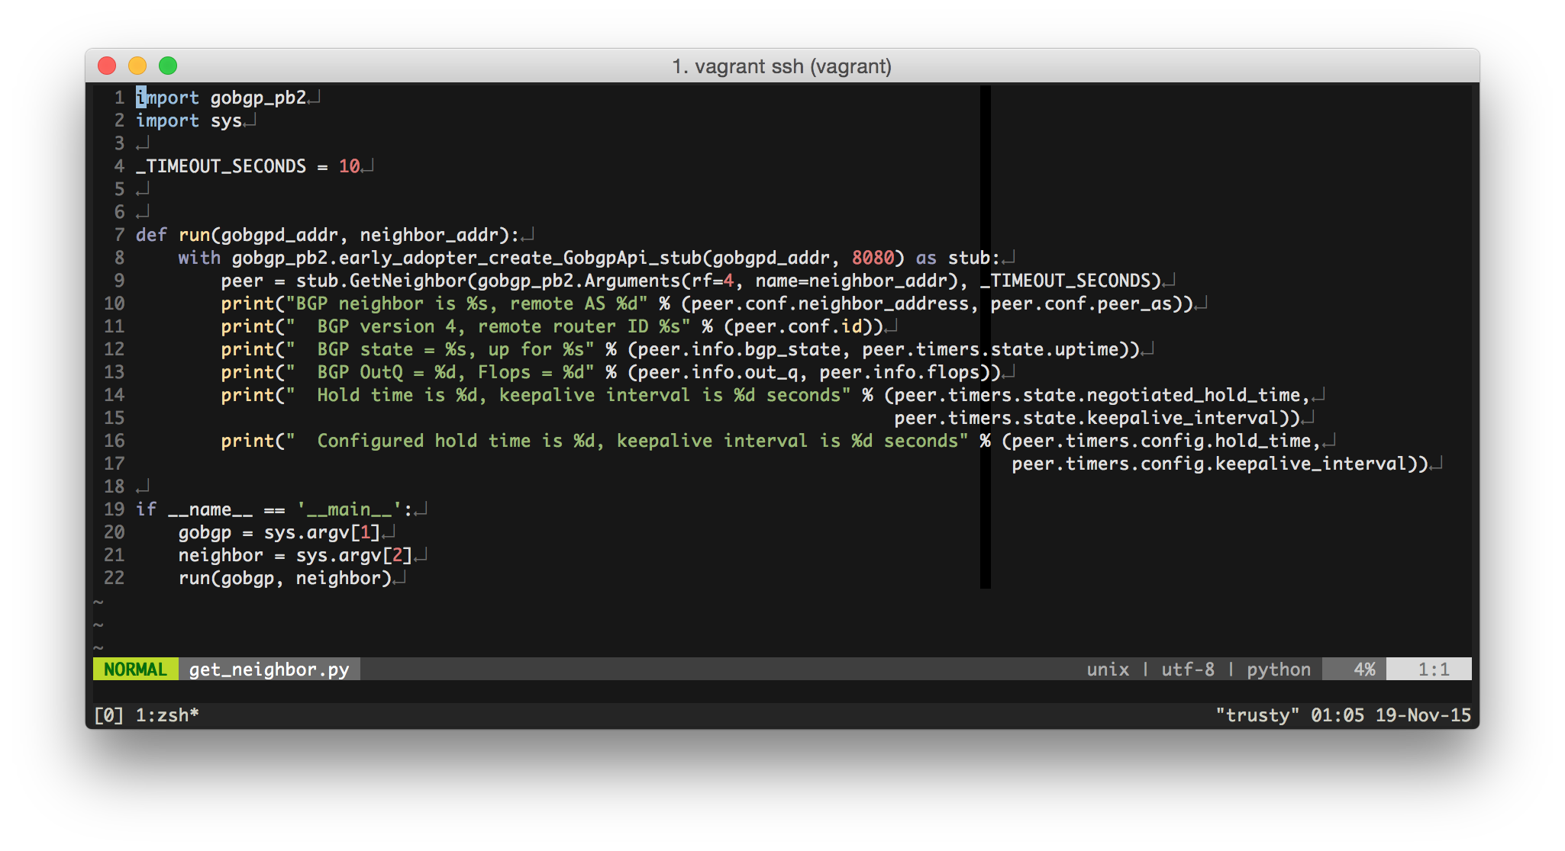
GoBGP Basics – use from python
This snippet results in…

Slide 16
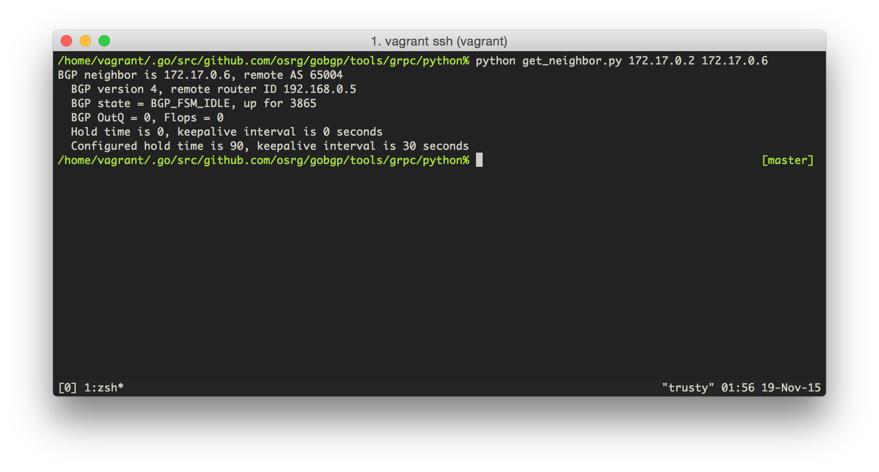
GoBGP Basics – use from python
This! No more “expect”

Slide 17
Main Target Application
1. High performance Router Server for IX
2. Integration with data analysis systems
3. BGPd for whitebox switches

Slide 18
Route Server for IX
GoBGP as a route server
supports multiple RIBs
flexible policy enforcement points
A
Adj-RIB-In for A
RIB for A
Adj-RIB-Out for A
A
B
Adj-RIB-In for B
RIB for B
Adj-RIB-Out for B
B
C
Adj-RIB-In for C
RIB for C
Adj-RIB-Out for C
C
: In Policy
: Import Policy
: Export Policy

Slide 19
Route Server for IX
Supported Policy Condition/Action
Condition
Prefix, Source neighbor
AS Path (contents, length)
Community, Extended Community
RPKI validation result
Action
Permit/Deny
Add/Replace/Remove (extended) community, med, aspath
Arithmetic operation of med

Slide 20
Main Target Application
1. High performance Router Server for IX
2. Integration with data analysis systems
3. BGPd for whitebox switches

Slide 21
Integration with data analysis systems
GoBGP as a BGP sub-system for data analysis
e.g) BGPmon(Colorado State Univ.), FastNetMon
A
B
BGP Peering
GoBGP
λ
gRPC
stream
processing
BigData
Analysis
C

Slide 22
Main Target Application
1. High performance Router Server for IX
2. Integration with data analysis systems
3. BGPd for whitebox switches

Slide 23
BGPd for whitebox switches
BIG wave of open-networking
Network commoditization
Expansion of the use of whitebox switches
GoBGP can be run on top of whitebox switches
Ported on Cumulus and Open Network Linux

Slide 24
BGPd for whitebox switches
FIB modification via zapi and netlink
zapi : api for zebra and quagga routing daemons
IPv4/IPv6 unicast FIB modification is done via zapi
Other FIB modification is done via netlink
e.g) zapi doesn’t support mac fdb modification
ospfd
gobgpd
zapi
Linux
User
Space
zebra
netlink
Linux
Kernel
Space
Linux Networking Subsystem

Slide 25
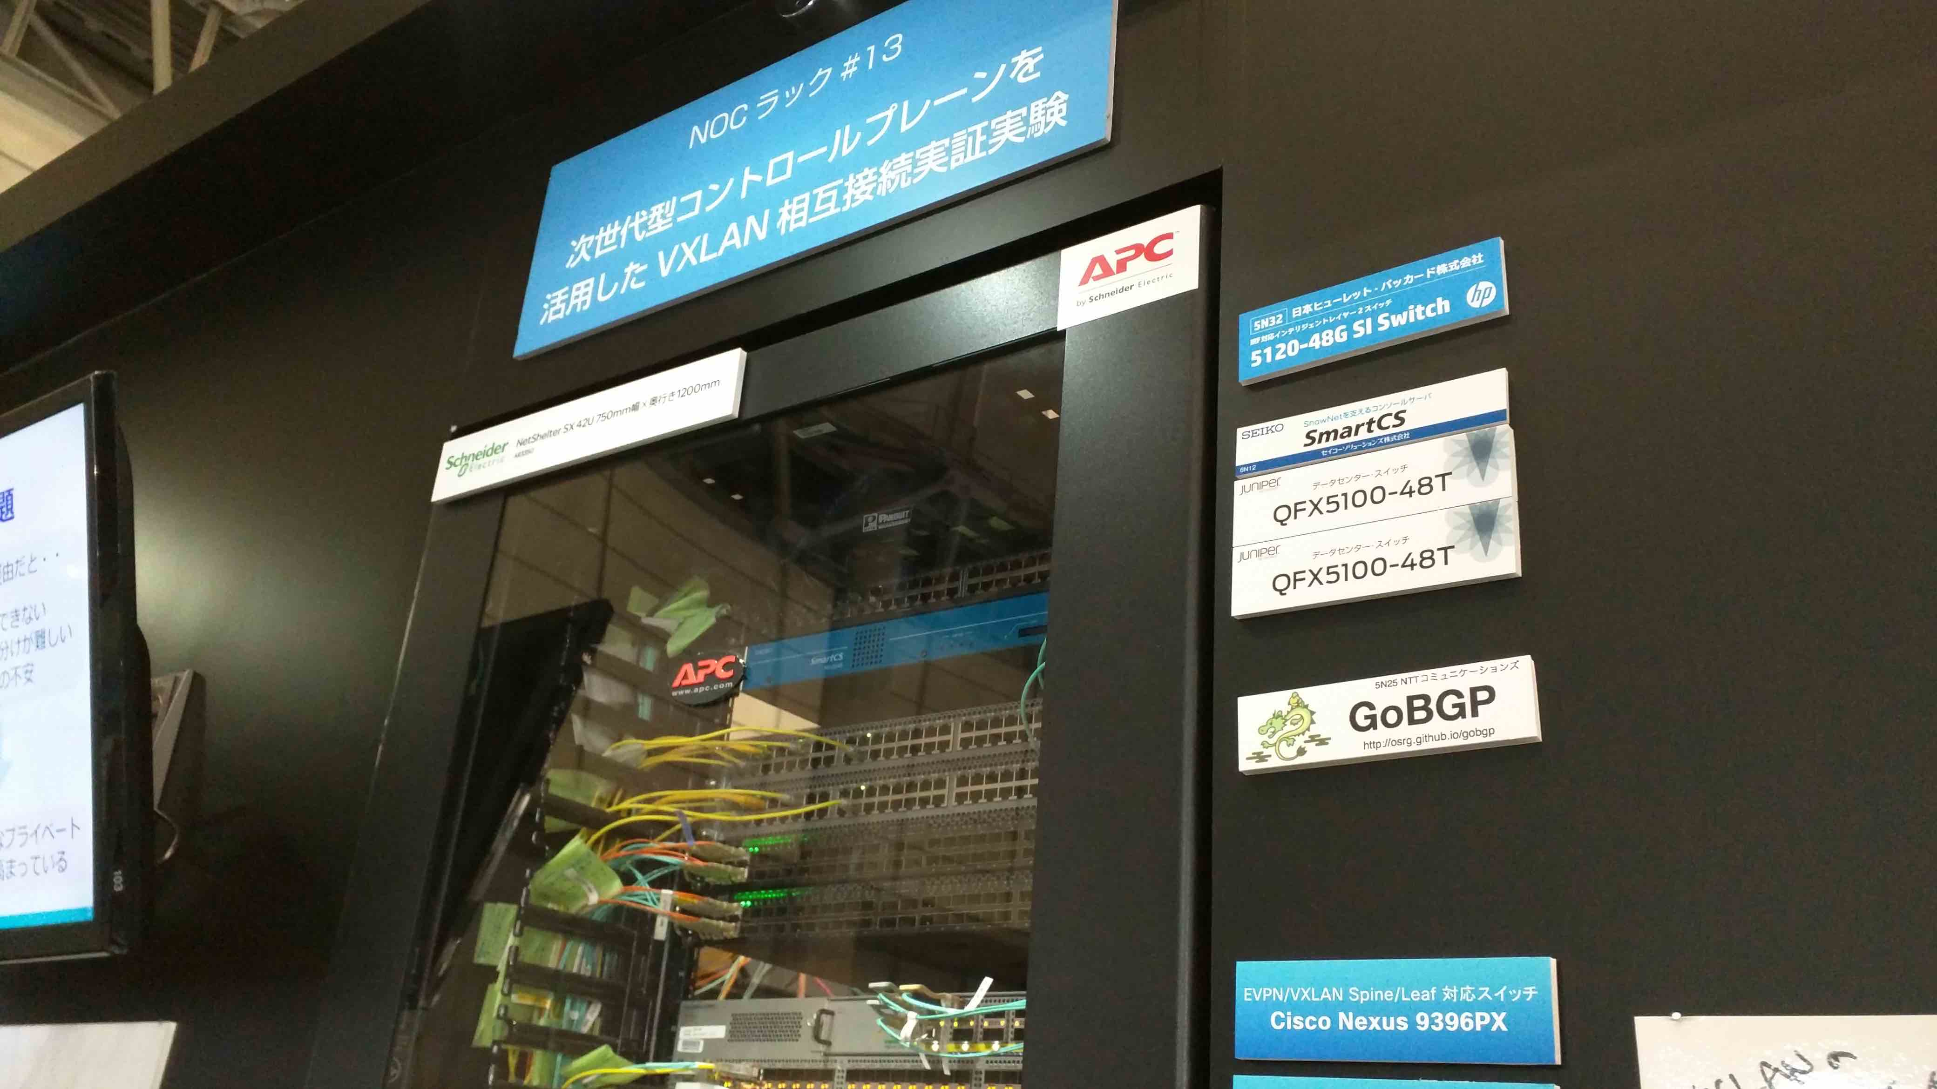
BGPd for whitebox switches
Usecase: EVPN+VXLAN
mac address exchange occers in BGP
Interoperability with Cisco/Juniper! @Interop Tokyo 2015

Slide 26
Other features
Full route MRT injection less than 1min
For testing your new gear
Route monitoring (MRT dump)
BMP is also on the roadmap
Route Reflector
Addpath is also on the roadmap
RPKI validation
Flowspec
VPN support (L2VPN(EVPN), L3VPN, VRF, RTC)

Slide 27
Summary
Please try it out !
Your comment, feedback, patch
and star on github is very welcome ;)

